Slide 1

Social Media Trends Analysis
Data-Driven Engagement Patterns Using Machine Learning
Mirco Fernando, BSc (Hons) – Software Engineering (Reading)
Zuu Crew Academy, Module: Machine Learning Foundations

Slide 2

Abstract: Unlocking Viral Success
This project investigated content trends across TikTok, Instagram, Twitter, and YouTube to identify key factors for viral success and predict engagement using machine learning.
Complex Data
Classification Success
Standard regression models were ineffective due to the non-linear, rapidly changing nature of social media data.
Classification models, especially XGBoost, performed best for engagement prediction. CatBoost effectively handled class imbalance.
Audience Segmentation
Unsupervised learning (KMeans, DBSCAN) identified three clear audience segments and unique viral content patterns.

Slide 3


Key Methodology
Our approach combined extensive feature engineering with supervised and unsupervised learning techniques to analyze social media engagement.
Feature Engineering
Over 60 predictive features were created to capture nuanced engagement patterns.
Supervised Learning
Regression for views, likes, shares, comments; classification for engagement levels.
Unsupervised Learning
PCA, t-SNE, UMAP for pattern discovery; KMeans & DBSCAN for segmentation.
Model Evaluation
Rigorous metrics ensured robust assessment of model performance.

Slide 4
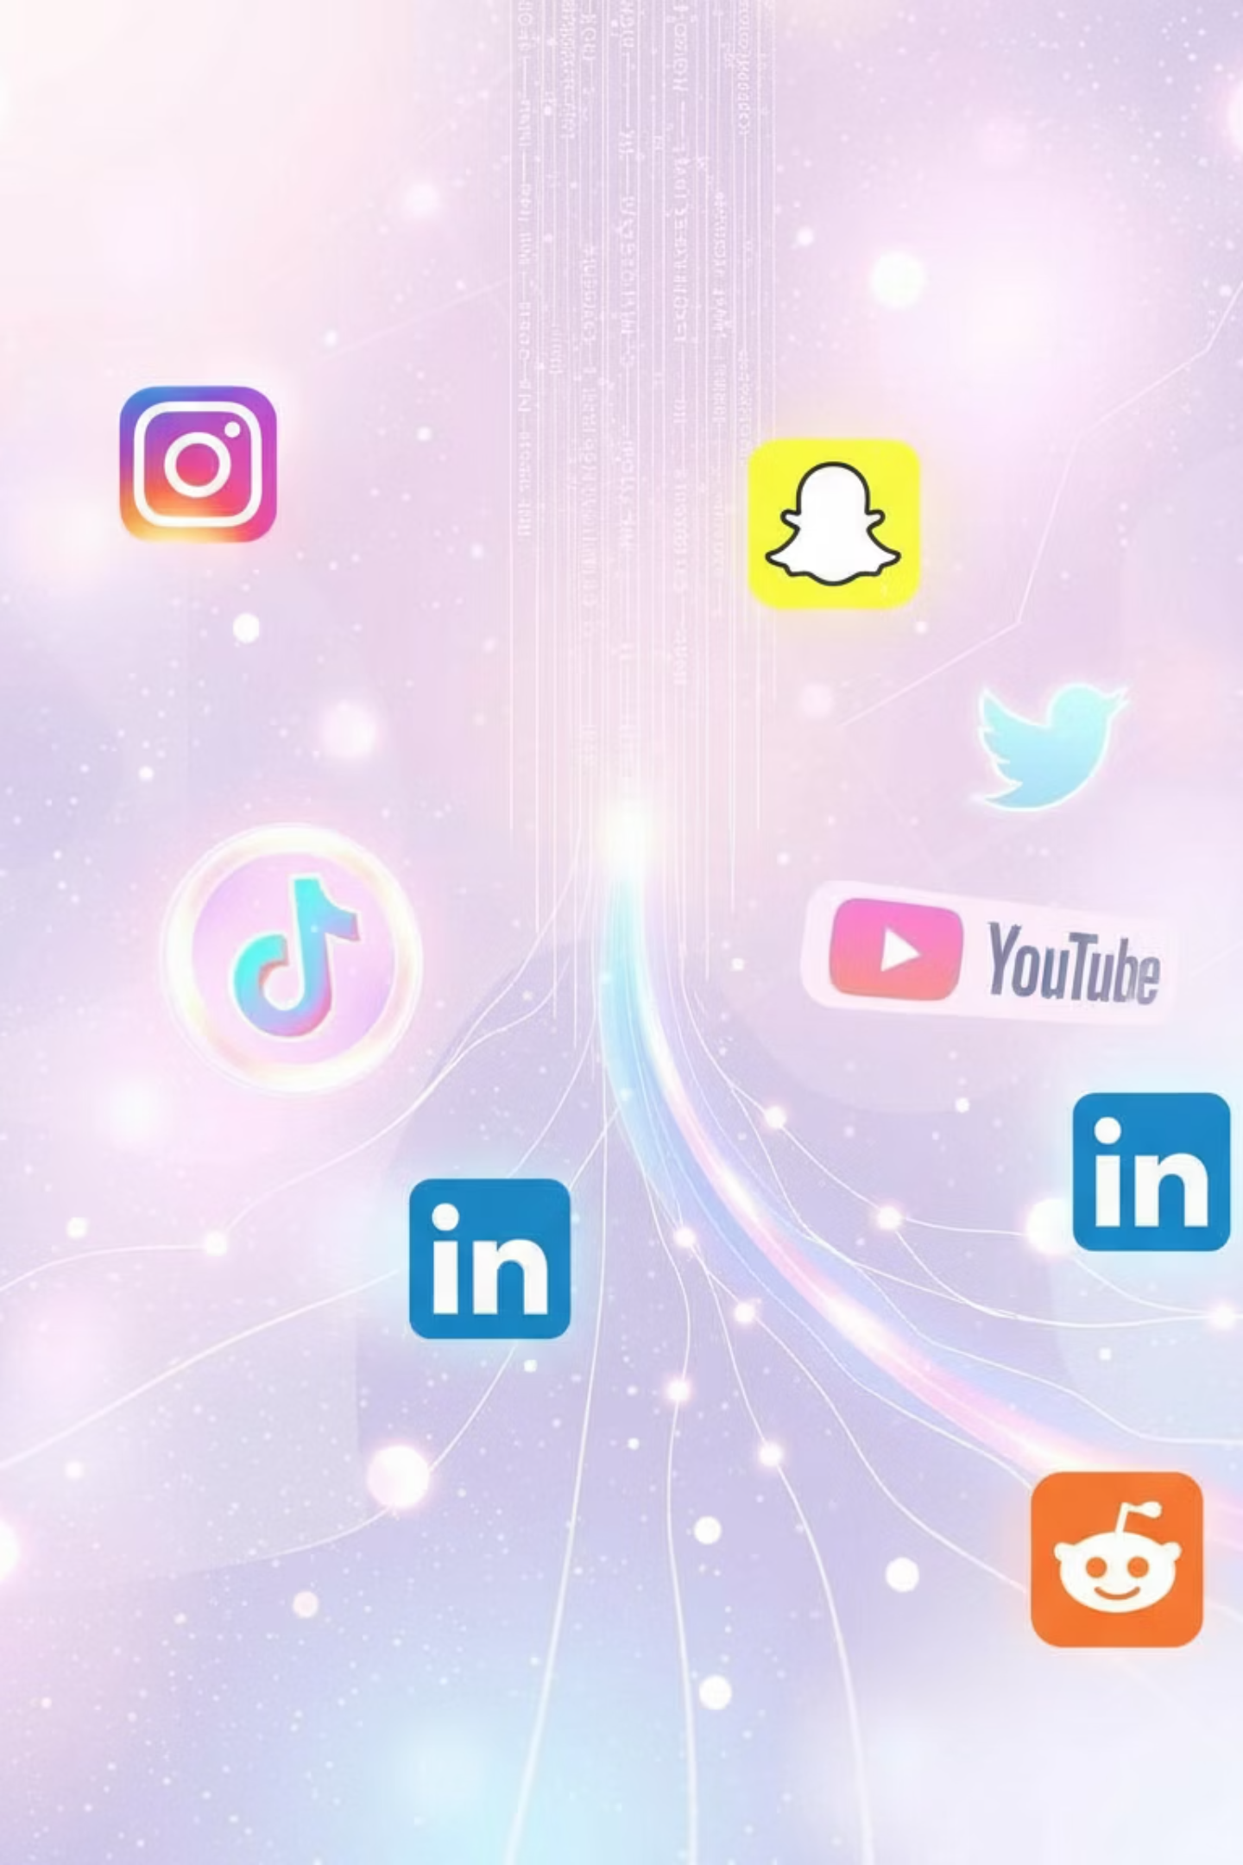
Introduction: The Social Media Landscape
Social media platforms are central to modern society, influencing communication, entertainment, culture, and commerce. With 5 billion users by 2025, engagement metrics are crucial for creators and businesses.
Motivation
Problem Statement
Reliable tools are needed to predict engagement and identify success patterns. Machine learning offers insights beyond manual analysis, modeling non-linear behavior and uncovering hidden structures.
Despite vast data, deriving meaningful insights is challenging due to platform diversity and user behavior. We lack integrated solutions for predicting metrics, classifying performance, and discovering hidden groups.

Slide 5



Data Investigation: Overview & Cleaning
Our dataset comprises social media posts from YouTube, Instagram, Twitter, and TikTok, including engagement statistics and metadata. Initial inspection revealed no missing data, but anomalies required careful handling.
Anomaly Investigation
Feature Engineering
Domain-impossible values (e.g., Likes exceeding Views) were removed (270 rows). Content type mismatches (1822 instances) were corrected by making assumptions (e.g., "Reel" on YouTube became "Shorts").
More than 70 engineered features were created, including the crucial Engagement Rate. This helps analyze audience interaction and inform strategies. Features for unsupervised learning were also developed, avoiding data leakage.
Improved Engagement level
The Engagement Level in the Dataset does aligned with real-world platform-specific engagement standards. The dataset calculates engagement levels using a quantile-based method. Newly Calculated Engagement Level will be used as the Classification Target that meets the platform specific rates.

Slide 6
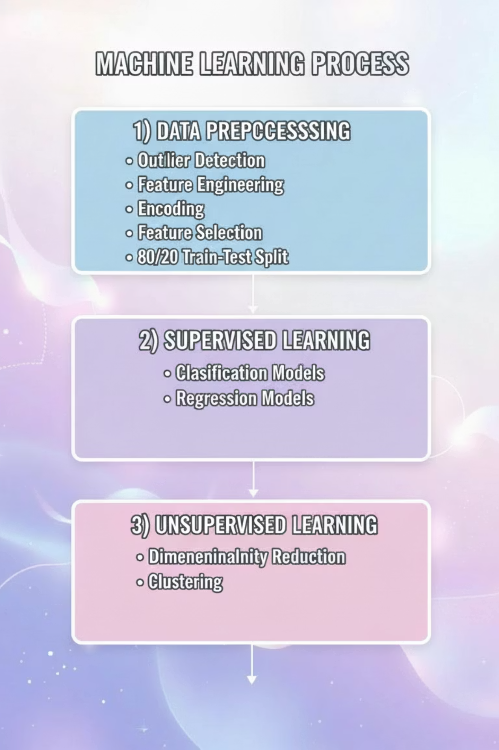
Methodology: Preprocessing & Model Development
A structured, leakage-free preprocessing workflow ensured data quality. Model development combined supervised and unsupervised methods for prediction and pattern discovery.
01
02
Data Preprocessing
Supervised Learning
Outlier detection, feature engineering, encoding, scaling, and feature selection were applied. An 80/20 train-test split prevented data leakage.
Models were trained to classify Engagement Levels and predict core metrics (Views, Shares, Comments, Likes).
03
Unsupervised Learning
Dimensionality reduction (PCA, t-SNE, UMAP) and clustering (K-Means, DBSCAN) were used to uncover hidden structures and behaviors.

Slide 7
Model Performance: Regression vs. Classification
Regression models failed to capture the non-linear nature of social media data, while classification models showed promising results.
Regression Performance
Classification Results
All regression models performed poorly with very high MAE/RMSE and negative R² scores. Social media engagement is non-linear, influenced by algorithms, virality, and real-time trends, which linear models cannot represent.
Classification models successfully categorized posts into Low, Medium, and High Engagement Levels. Tree-based models (Random Forest, XGBoost, CatBoost) captured non-linear decision boundaries effectively.
Metric
Linear Regression
Ridge (α = 100)
Model
Test Accuracy
Test F1
Logistic Regression
0.76
0.79
Views R²
-0.01778
-0.0177
Likes R²
-0.009312
-0.0089
Decision Tree
0.72
0.76

Slide 8

Hyperparameter-Tuned Classification & Feature Importance
Advanced models with hyperparameter tuning improved classification using SMOTE. CatBoost emerged as the most balanced and interpretable model, especially for handling class imbalance.
1
2
XGBoost
Random Forest
Achieved highest test accuracy (0.786) and recall, showing strong overall balance.
Delivered best precision (0.816), producing fewer false positives.
3
CatBoost
Competitive performance, effectively handled class imbalance, and provided meaningful feature importances.
CatBoost's feature importance highlighted time-based and temporal interaction features (comments_per_month, days_since_first_post) as key drivers of engagement.

Slide 9


Unsupervised Learning: Discovering Hidden Patterns
Unsupervised methods provided structural insights, revealing hidden distributions and content groupings within the dataset.
Dimensionality Reduction
Clustering Analysis
PCA, t-SNE, and UMAP were applied. PCA showed variance dispersed across many features. t-SNE revealed local groupings, while UMAP captured more continuous patterns, though engagement classes still overlapped.
K-Means identified three stable macro-behavior groups (high-engagement, medium-engagement, low-engagement). DBSCAN detected many small niche behavior groups and outliers, including viral posts.

Slide 10
Strategic Recommendations
Our findings provide practical, data-backed recommendations for optimizing social media content strategy.
Leverage Top Predictors
Prioritize Short-Form Content
Platform-Specific Strategies
Focus on interaction intensity (likes, shares, comments per month) as primary drivers of engagement.
Instagram, TikTok, and YouTube have varying engagement potentials. Use YouTube for long-form, and Instagram/TikTok for short-form content.
Short-form content (Reels, Shorts, TikTok) maximizes early interactions and drives high engagement.
Regional & Hashtag Optimization
Analyze Viral Outliers
Tailor content to regions and use trending hashtags (e.g., #Fitness, #Comedy, #Viral) for specific platforms and demographics.
Study DBSCAN's noise points (viral anomalies) to understand triggers (timing, content type, hashtags) and reproduce success.

